Slide 1
Term Project Iteration 5 Walkthrough

Slide 2
Iteration 5 Components
Reusable, Transaction-Oriented Store Procedures
You create and execute reusable stored procedures that complete the steps of transactions necessary to add data to your database.
Questions and Queries
You define questions useful to the organization or application that will use your database, then write queries to address the questions.
Index Placement and Creation
To speed up performance, you identify columns needing indexes for your database, then create them in SQL.
Notes:
This iteration is about putting data into your database and answering questions from the data.
In this iteration, you insert data transactionally with stored procedures, define questions useful to the organization or application, and answer them with well-written queries.
After your hard work, you get to see your database in action!

Slide 3
Reusable, Transaction-Oriented Store Procedures

Slide 4
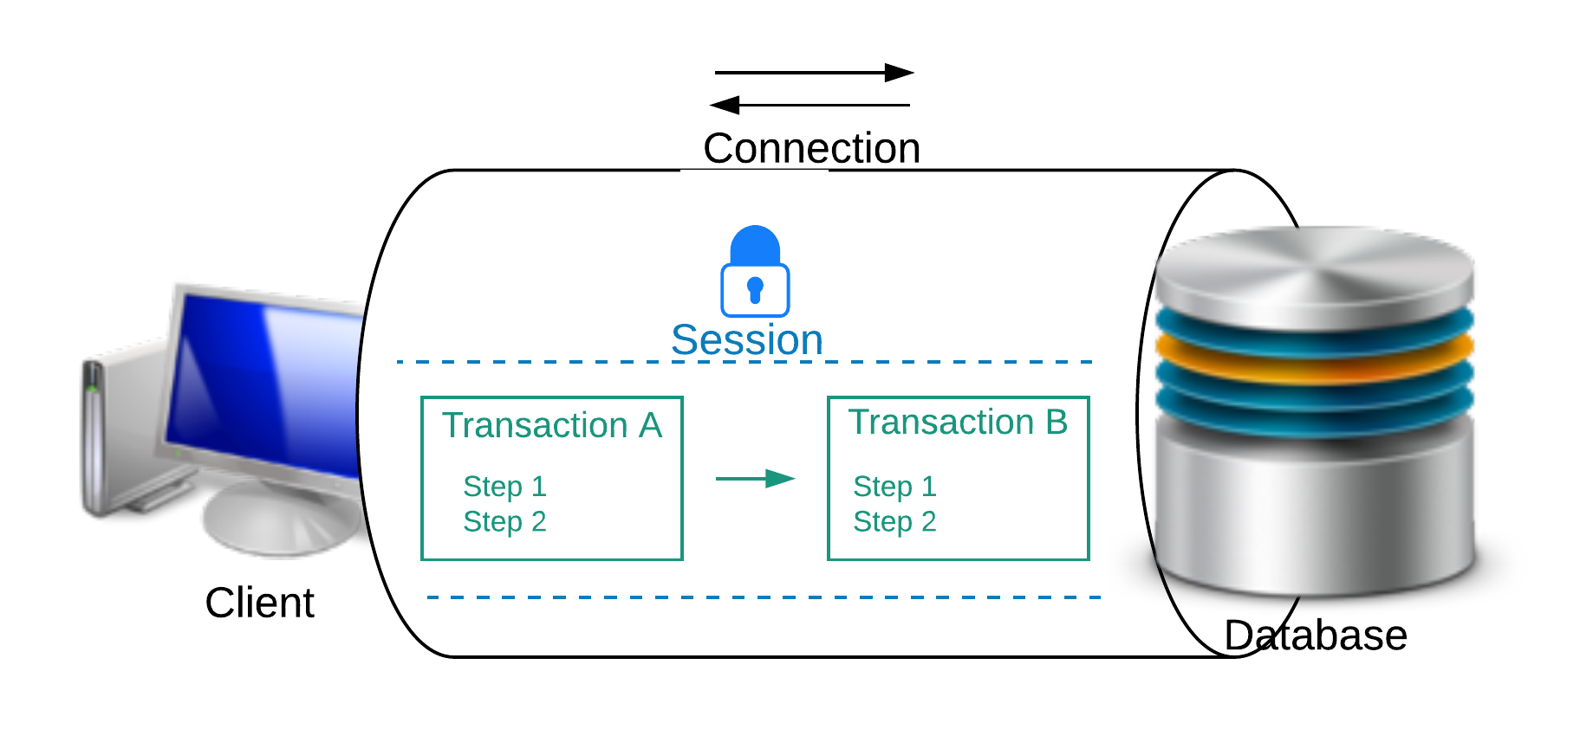
Transaction Visual
Notes:
It is important to understand foundational concepts before attempting to understand deadlocks.
Some foundational concepts are connections, sessions, transactions, schedules, and locks.
DBMS such as Oracle and Microsoft SQL Server support connections^{1,2}.
A connection is a communication pathway between a client process and a database instance.
Each session is associated with a connection¹.
When a client application connects and authenticates a user to a database instance, a session is created in the instance’s memory.
The session lasts from the time the user is authenticated by the instance, until the time the application disconnects from the database application^{1,2.}
Session are independent, meaning that transaction control statements in one session do not affect control statements in other transactions.
Multiple sessions can exist concurrently for a single database user.
Transactions are executed within the context of a session^{1,2}.

Slide 5

Example – Account Transfer
Notes:
A transaction is a unit of work in the database.
A transaction may consist of many steps, though all steps work together to accomplish a broader task.

Slide 6
Technical Example – Pay Raise
new_salary = select employee_salary from salary where employee_id = 123
new_salary = new_salary * 1.05
Update salary Set employee_salary = new_salary Where employee_id = 123

Slide 7
Transactions’ Use of Data
It is important to note that there are two distinct locations for data for a transaction – the database’s data and the transaction’s temporary use of data.
When a transaction retrieves a value from the database, the transaction then has a local copy of that value that it can work with.
Local copies are not automatically pushed to the database. The transaction must choose to push it.
Notes:
Transactions often make use of temporary memory, as in the above example. Variables in temporary memory do not affect the database. The database can be updated explicitly with update/insert/delete statements.

Slide 8

Transaction Outcomes
Notes:
Transactions can have one of two outcomes:
Success – a transaction commits and the database reaches a new consistent state.
Failure – a transaction aborts, and the database must be restored to the consistent state before it started. Such a transaction is rolled back or undone.
A committed transaction cannot be aborted.
An aborted transaction cannot be committed. The same steps however can be re-executed in a new transaction.

Slide 9
Five ACIDS Transaction Properties
Atomicity is the “All or nothing” property. All changes in the transaction are applied, or none of them are applied. There is no middle ground.
Consistency Transactions must transform the database from one consistent state to another.
Isolation Changes made by incomplete (uncommitted) transactions should not be visible to other transactions.
Durability The effects of a committed transaction are permanent and must not be lost because of later failure of the platform or DBMS.
Serializability To each transaction the database behaves as if this were the only transaction.

Slide 10
Transaction Summary
A transaction is a unit of work in the database.
Transactions have two outcomes – commitment (success) and abortion (failure).
Transactions make use of temporary memory for variables and read and write to the database as needed.
Transactions are atomic, consistent, isolated, durable, and serializable.

Slide 11
Stored Procedure Review
A stored procedure is a named code segment that can be executed by name as needed.
Stored procedures can contain SQL code and business logic as needed.
Stored procedures can take parameters whereby the caller specifies the values when executing the procedure.

Slide 12
Transactions in Procedures
Some organizations use a method whereby transactions are implemented in reusable stored procedures.
Such a stored procedure takes one or more parameters, and completes all of the steps in the transaction using the values the caller specified in the parameters.
Use of this method allows database developers to implement the transactions in the database, eliminating the need for the application to implement all of the steps.

Slide 13
Advantages of Transactions in Procedures
Separation of concerns – The application developers can focus on the application and the database developers can focus on the database.
It’s not necessary for the application to connect over the network repeatedly to execute SQL, resulting in better performance.
Transaction steps can be updated without the need to redeploy the application.
I.T. staff can execute a transaction manually when necessary to correct an issue, or for other purposes

Slide 14
Disadvantages of Transactions in Procedures
Requires significant coordination between application developers and database developers.
Application logic effectively spans two languages – the language of the application and the language of the database.
Modern application languages have evolved far beyond database programming languages.

Slide 15
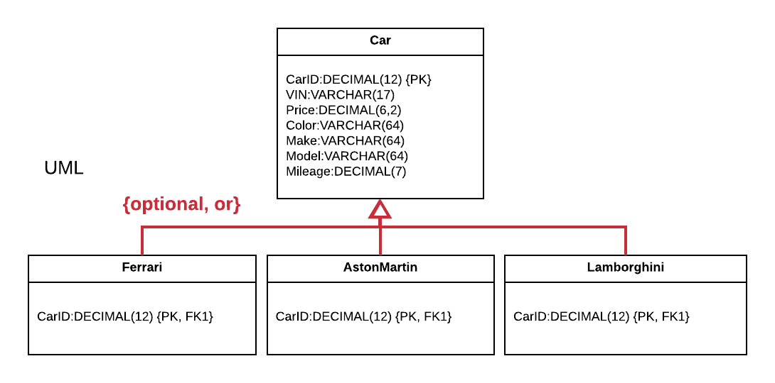
Example Car EERD with Attributes

Slide 16
Example Car Reseller Use Case
The car reseller purchases a used Ferrari to sell.
The car salesperson enters the Ferrari’s information into the system including its make, model, and other important information.
We know that we have two tables – Car and Ferrari – that are relevant to Ferraris, so we need two insert statements for each of those tables in our transaction.

Slide 17
Basic Stored Procedure - Oracle
CREATE OR REPLACE PROCEDURE AddFerrari(CarID IN DECIMAL, VIN IN VARCHAR,
Price IN DECIMAL, Color IN VARCHAR, Make IN VARCHAR, Model IN VARCHAR,
Mileage IN DECIMAL)
AS
BEGIN
INSERT INTO Car(CarID, VIN, Price, Color, Make, Model, Mileage)
VALUES(CarID, VIN, Price, Color, Make, Model, Mileage);
INSERT INTO Ferrari(CarID)
VALUES(CarID);
END;
BEGIN
AddFerrari(1, '1XPADB9X4TN402579', 295000, 'Giallo Modena',
'Ferrari', 'F12berlinetta', 20000);
COMMIT;
END;
Notes:
Note that this stored procedure has the basic transaction steps, but does not implement error checking and other features that a more robust implementation would implement.

Slide 18
Basic Stored Procedure – SQL Server
CREATE PROCEDURE AddFerrari @CarID DECIMAL(12), @VIN VARCHAR(17),
@Price DECIMAL(8,2), @Color VARCHAR(64), @Make VARCHAR(64),
@Model VARCHAR(64), @Mileage DECIMAL(7)
AS
BEGIN
INSERT INTO Car(CarID, VIN, Price, Color, Make, Model, Mileage)
VALUES(@CarID, @VIN, @Price, @Color, @Make, @Model, @Mileage);
INSERT INTO Ferrari(CarID)
VALUES(@CarID);
END;
BEGIN TRANSACTION AddFerrari;
EXECUTE AddFerrari 1, '1XPADB9X4TN402579', 295000,
'Giallo Modena', 'Ferrari', 'F12berlinetta', 20000;
COMMIT TRANSACTION AddFerrari;
Notes:
Note that this stored procedure has the basic transaction steps, but does not implement error checking and other features that a more robust implementation would implement.

Slide 19
Basic Stored Procedure - Postgres
CREATE OR REPLACE FUNCTION AddFerrari(CarID IN DECIMAL, VIN IN VARCHAR, Price IN DECIMAL,
Color IN VARCHAR, Make IN VARCHAR, Model IN VARCHAR, Mileage IN DECIMAL)
RETURNS VOID
AS
$proc$
BEGIN
INSERT INTO Car(CarID, VIN, Price, Color, Make, Model, Mileage)
VALUES(CarID, VIN, Price, Color, Make, Model, Mileage);
INSERT INTO Ferrari(CarID)
VALUES(CarID);
END;
$proc$ LANGUAGE plpgsql
START TRANSACTION;
DO
$$BEGIN
EXECUTE AddFerrari(1, '1XPADB9X4TN402579', 295000, 'Giallo Modena',
'Ferrari', 'F12berlinetta', 20000);
END$$;
COMMIT TRANSACTION;
Notes:
Note that this stored procedure has the basic transaction steps, but does not implement error checking and other features that a more robust implementation would implement.

Slide 20
Questions and Queries

Slide 21
Organization-Driven Queries
We focus on writing queries that are based on what the organization needs and how the database will be used.
These can be phrased in the form of questions.

Slide 22
Car Question and Query Example
How many cars of each make are available?
SELECT Make, Count(*) AS NumberAvailable
FROM Car
GROUP BY Make
ORDER BY Make;

Slide 23
Your Work for This Component
Create questions according to the term project instructions, then write queries to address the questions.
Update your script to contain all of your queries.
Each query should have an associated comment which describes the question it’s answering.
Also provide screenshots of the execution of each query and its results in your iteration.

Slide 24
Tips for This Component
In order to show useful results, you will need enough rows and variety in your tables.
Make sure to explain the logic of your query and how it shows the expected results.
Make sure the questions are significant and useful to your organization or application, focused on the core operations and not extraneous or side operations.

Slide 25
Index Placement and Creation

Slide 26
Indexing Overview
Virtually all relational databases, even well-designed ones, perform terribly without deliberate creation of indexes.
Logical database design deals with the structurally independent tables and relationships; index placement deals with the way the database will access your data, how long that will take, and how much work the database must perform to do so.
An index is a physical construct that is used to speed up data retrieval.
From a logical design perspective, indexes are invisible.
Indexes are critical component in database performance, and index placement happens mostly during the design phase of a database.

Slide 27
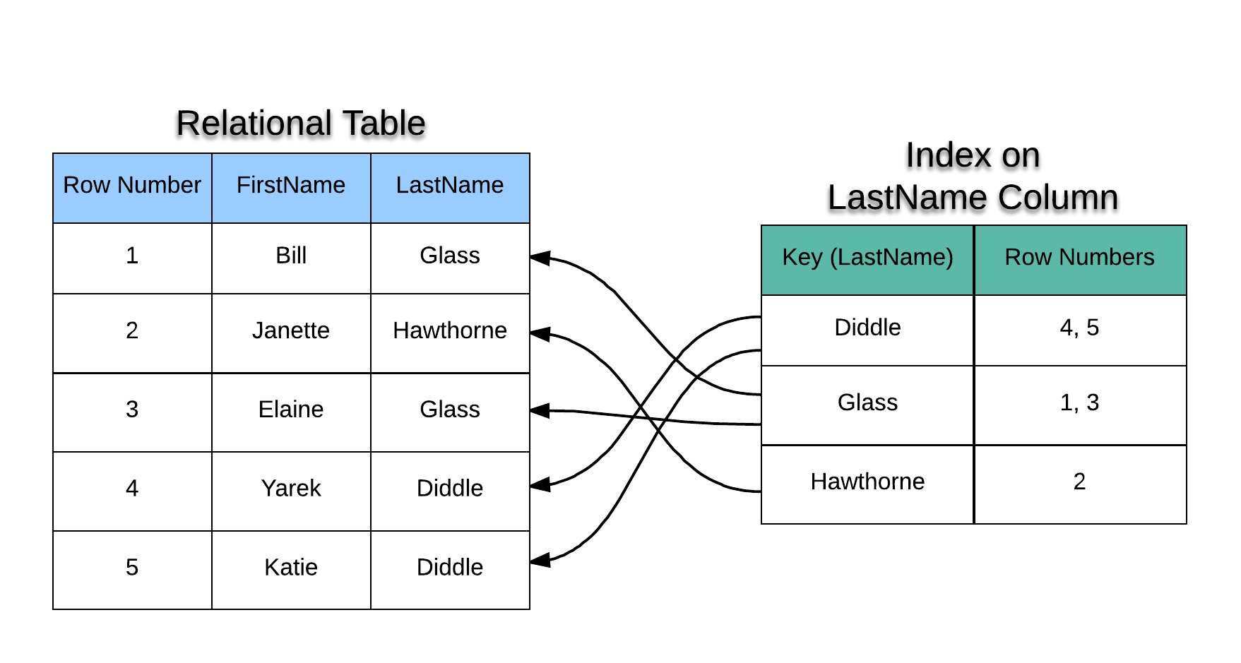
Example Index
Notes:
In the example above, there are two data columns in the relational table – FirstName and LastName.
You may have noticed the RowNumber column as well.
Every relational table has an identifier for each row created automatically by the database

Slide 28
Maintaining Uniqueness
An index can be implemented to allow the key values to repeat (non-unique index), or can be implemented to disallow repeating keys (unique index).
Many modern relational DBMS enforce uniqueness constraints through automatic creation of unique indexes.
You can enforce uniqueness by creating a unique constraint or by directly creating a unique index.
For every index we create, we must decide whether an index is unique or non-unique.

Slide 29
Deciding Which Columns Deserve Indexes
Why not simply add indexes to every column in the schema?
Indexes speed up reading from the database, but slow down writing to the database.
Indexes take extra storage space.
Indexes add complexity to database maintenance.
We carefully decide which columns deserve an index based upon certain criteria.

Slide 30
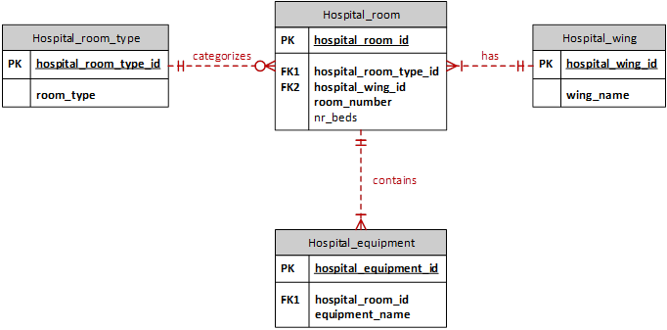
Example Hospital Room Schema

Slide 31
Primary Keys are Already Indexed
Many modern relational DBMS, including Oracle, SQL Server, and Postgres automatically add unique indexes to table columns covered by a primary key constraint. We do not need to add indexes to primary keys.
Primary Key Column | Description
Hospital_room.hospital_room_id | This is the primary key of the Hospital_room table.
Hospital_equipment.hospital_equipment_id | This is the primary key of the Hospital_equipment table.
Hospital_wing.hospital_wing_id | This is the primary key of the Hospital_wing table.
Hospital_room_type.hospital_room_type_id | This is the primary key of the Hospital_room_type table.

Slide 32
Foreign Keys Should Always Be Indexed
All foreign key columns should be indexed without regard to any other requirements or the SQL queries that will use them.
Foreign Key Column | Description
Hospital_room.hospital_room_type_id | This foreign key in the Hospital_room table references the Hospital_room_type table. The index is non-unique since many rooms can be of the same type.
Hospital_room.hospital_wing_id | This foreign key in the Hospital_room table references the Hospital_wing table. The index is non-unique since there are many rooms in the same wing.
Hospital_equipment.hospital_room_id | This foreign key in the Hospital_equipment table references the Hospital_equipment table. This index is non-unique since one room can contain may pieces of equipment.
Notes:
Some DBMS, including Oracle, will sometimes escalate a row-level lock to a page-level lock when a SQL join is performed.
Foreign keys will almost always be used in the WHERE clauses of SQL queries that perform joins between the referencing tables and the referenced tables.

Slide 33
Query-Driven Index Placement
Other than foreign keys, we add indexes to columns based upon how they are expected to be used in queries.
Columns in WHERE clauses or join conditions are usually indexed.
Indexes on tables that remain small are usually not beneficial.
If queries always retrieve most rows in a table, indexes on that table are not usually beneficial.
Avoid indexing columns with a small number of distinct values or a large percentage of nulls.

Slide 34
Hospital Beds Query
SELECT Hospital_room.room_number
FROM Hospital_room
WHERE Hospital_room.nr_beds = 3
We index the nr_beds column because it exists in the WHERE clause and will be used to restrict the rows.
It would be non-unique since multiple rooms can have the same number.

Slide 35
Room Type Query
SELECT Hospital_room.room_number
FROM Hospital_room
JOIN Hospital_room_type ON Hospital_room.hospital_room_type_id =
Hospital_room_type.hospital_room_type_id
WHERE Hospital_room_type.room_type = ‘Standard Inpatient’
Hospital_room.hospital_room_type_id and Hospital_room_type.hospital_room_type_id are both used in a join condition but are already indexed as foreign keys.
Hospital_room_type.room_type appears in the WHERE clause so we will want to index it. It’s unique as a domain table (though the FK to it is not unique).

Slide 36
Rooms with Computers Query
SELECT Hospital_room.room_number
FROM Hospital_room
WHERE Hospital_room.hospital_room_id
IN (SELECT Hospital_equipment.hospital_room_id
FROM Hospital_equipment
WHERE Hospital_equipment.equipment_name = ‘Computer’)
Because equipment_name is in the WHERE clause of the subquery, we add an index to that column. It’s non-unique.
Hospital_room.hospital_room_id is the primary key of hospital_room and so already has an index.

Slide 37
Creating Indexes in your Database
Indexes need to be created in SQL for the database to take advantage of them.
The same commands can be used across Oracle, SQL Server, and Postgres.
CREATE INDEX IndexName
ON TableName (ColumnList);
CREATE UNIQUE INDEX IndexName
ON TableName (ColumnList);

Slide 38
Example Car Index
CREATE TABLE Car (
CarID DECIMAL(12) NOT NULL PRIMARY KEY,
VIN VARCHAR(17) NOT NULL,
Price DECIMAL(8,2) NOT NULL,
Color VARCHAR(64) NOT NULL,
Make VARCHAR(64) NOT NULL,
Model VARCHAR(64) NOT NULL,
Mileage DECIMAL(7) NOT NULL);
CREATE INDEX CarPriceIdx
ON Car(Price);
CREATE UNIQUE INDEX CarVINIdx
ON Car(VIN);
Notes:
This creates a non-unique index on the Price column, and a unique index on the VIN column.

Slide 39
Tips for Adding Indexes
Carefully choose your columns to index based upon the principles taught.
Explain why you chose the column for indexing.
Make sure to decide between unique and non-unique for each index.
Add all of your index creations to your script. There is no need to drop them because dropping the table drops the index and all data in the table.

Slide 40

End

